Slide 1


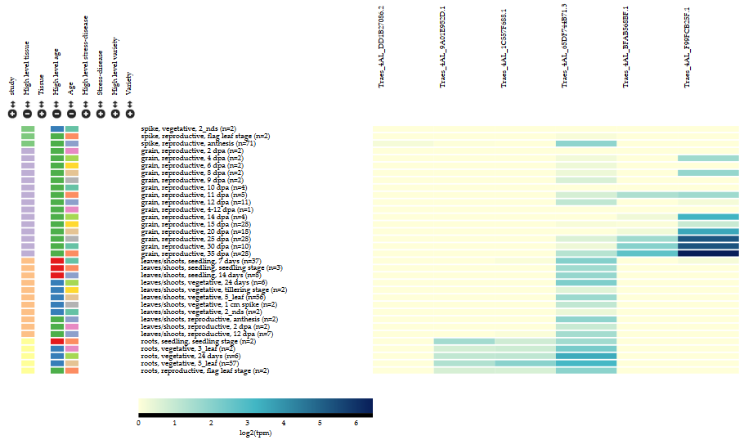
Wheat Gene Expression Browser Implemented by the expVIP customisable RNA-Seq data analysis and visualisation platform
Cristobal Uauy (cristobal.uauy@jic.ac.uk)
@CristobalUauy

Slide 2
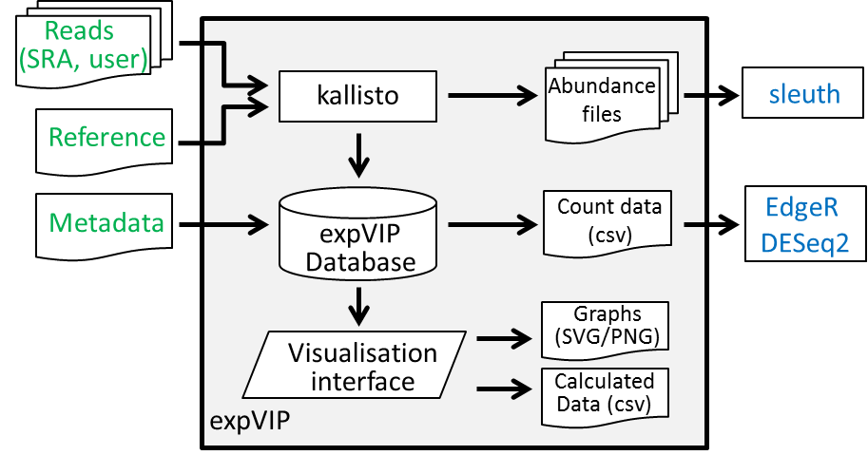
expVIP (expression Visualisation and Integration Platform)
Differential
Expression
Input
ExpVIP
Borrill et al., 2016. Plant Physiology

Slide 3
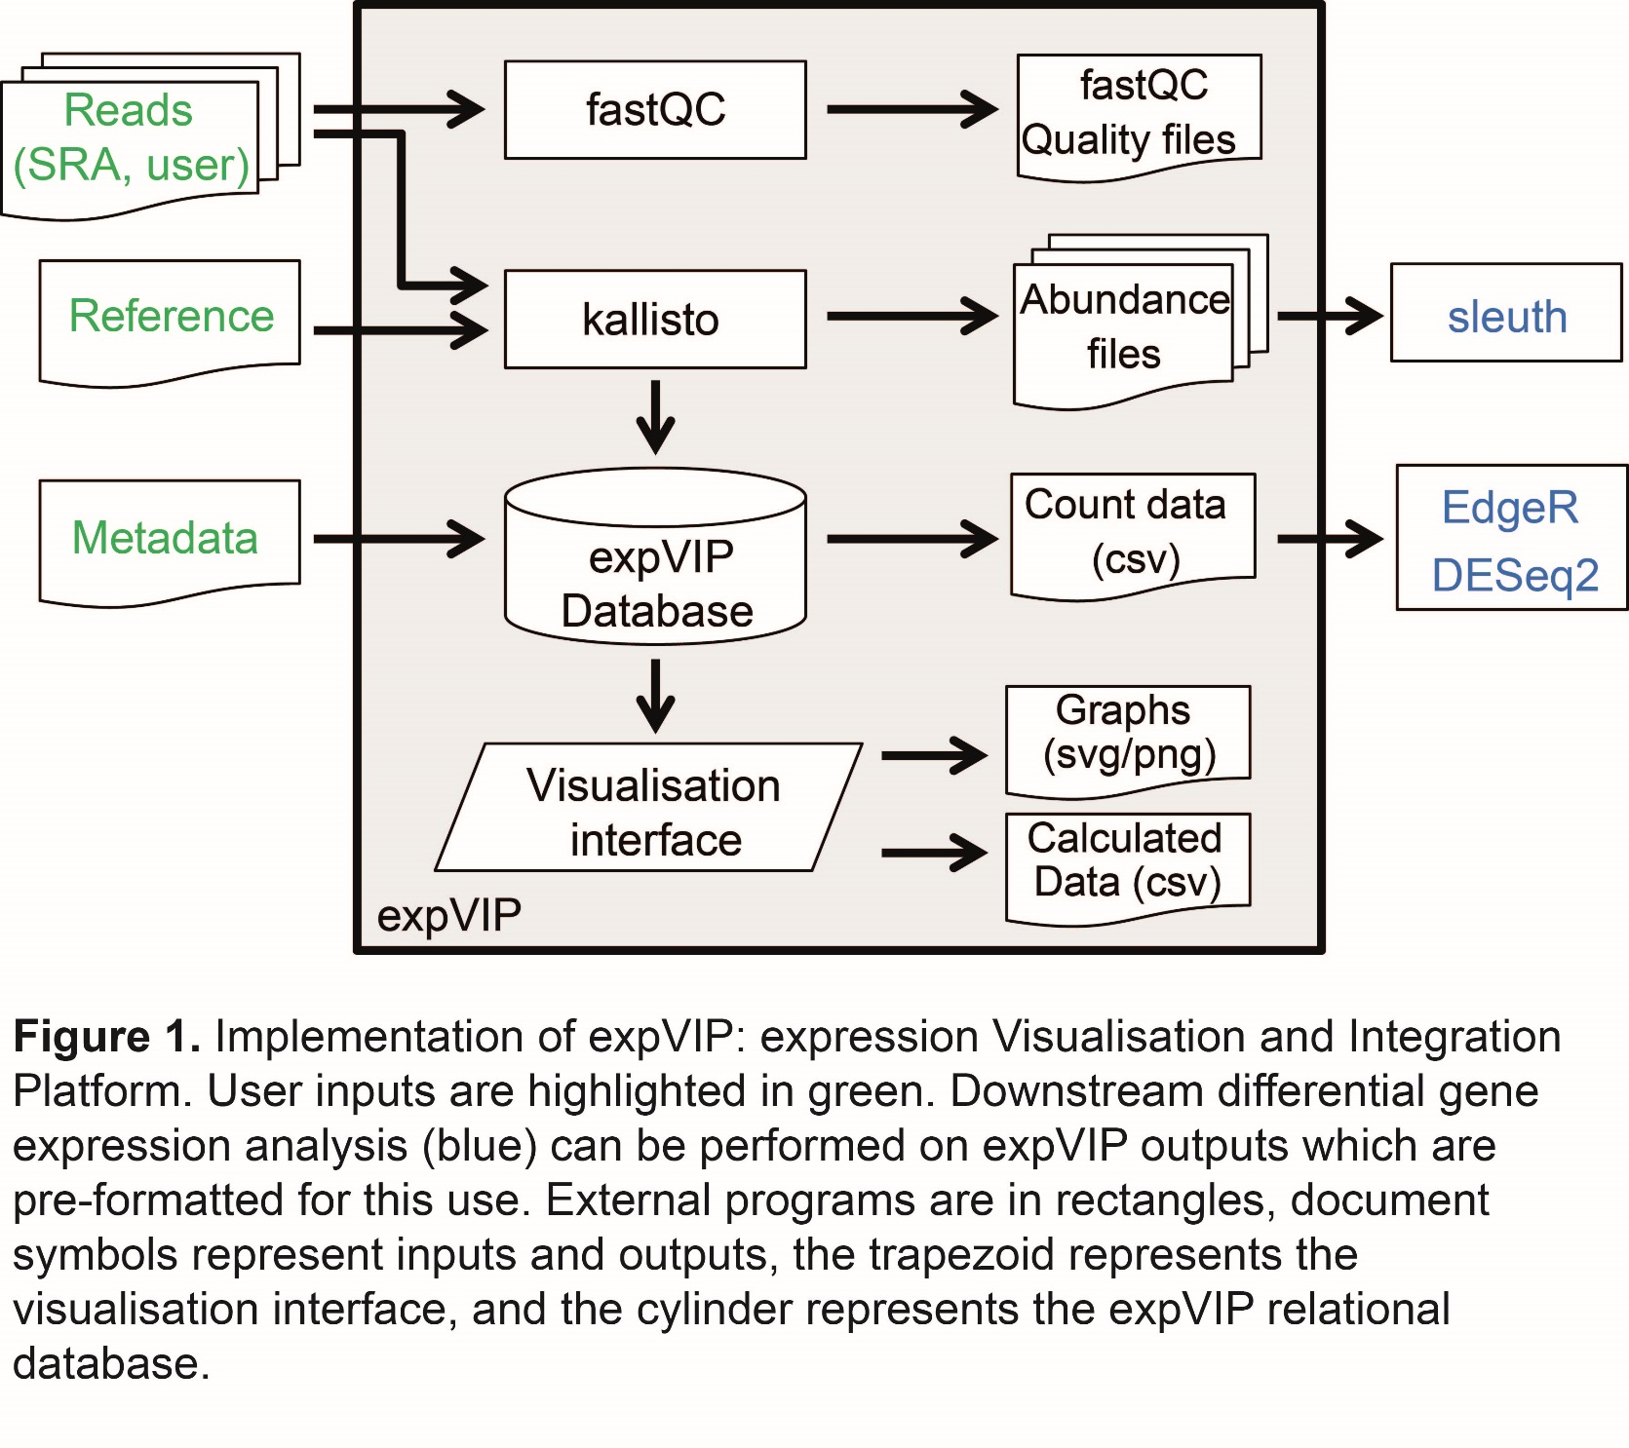
Input files
Fastq files from SRA (418 RNA-seq samples)
Internal/personal files
IWGSC v 2.26 transcriptome
103,274 genes; Choulet et al., 2014; IWGSC, 2014
TGAC v 1.0 transcriptome (HC + LC)
273,739 transcripts; Clavijo et al. 2016 bioRxiv
Information to classify samples
(tissue, developmental stage, stress, variety)

Slide 4
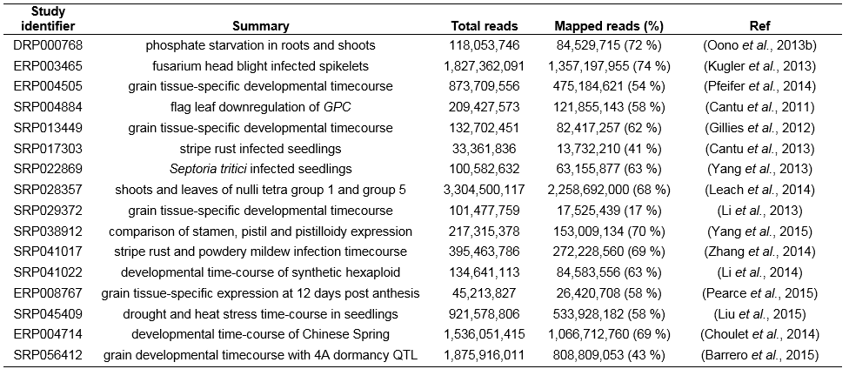
Input SRA reads
16 studies; 418 RNA-seq samples; 11 billion reads; >USD $200k

Slide 5
Metadata: tissue, developmental stage, stress, variety

Slide 6
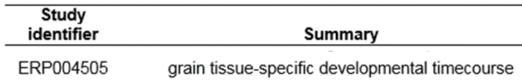
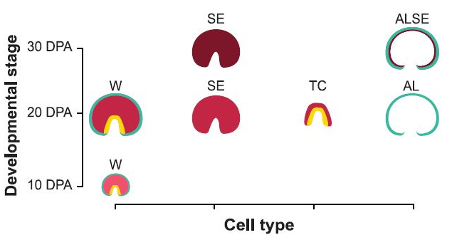
Metadata
Tissue: Grain aleurone, endosperm, etc
Dev. Stage Reproductive 10, 20, 30 dpa
Stress None none
Variety CS CS
Pfeifer et al 2014 Science

Slide 7
Tissue
Dev. stage
Stress
High level | tissue
grain | Endosperm
 | Transfer cells
 | …
shoots | Flag leaf
 | 2nd leaf
 | …
spike | Spikelets
 | Stamen
 | …
roots | roots
High level | Dev stage
seedling | 7 days
 | 14 days
 | …
Vegetative | 3 leaf stage
 | 5 leaf stage
 | …
Reproductive | Anthesis
 | 5 dpa
 | 10 dpa
 | …
High level | Stress
none | None
Disease | Septoria 4 dpi
 | Septoria 10 dpi
 | Mildew 24 h
 | Yellow rust 3 dpi
 | …
Abiotic | Heat (1 h)
 | Drought (6h)
 | P starvation (10 d)
 | …

Slide 8
Tissue
Dev. stage
Stress
High level | tissue
grain | Endosperm
 | Transfer cells
 | …
shoots | Flag leaf
 | 2nd leaf
 | …
spike | Spikelets
 | Stamen
 | …
roots | roots
High level | Dev stage
seedling | 7 days
 | 14 days
 | …
Vegetative | 3 leaf stage
 | 5 leaf stage
 | …
Reproductive | Anthesis
 | 5 dpa
 | 10 dpa
 | …
High level | Stress
None | None
Disease | Septoria 4 dpi
 | Septoria 10 dpi
 | Mildew 24 h
 | Yellow rust 3 dpi
 | …
Abiotic | Heat (1 h)
 | Drought (6h)
 | P starvation (10 d)
 | …

Slide 9
kallisto
Bray et al 2016 Nature Biotech

Slide 10
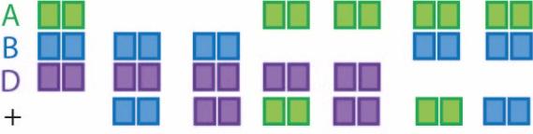
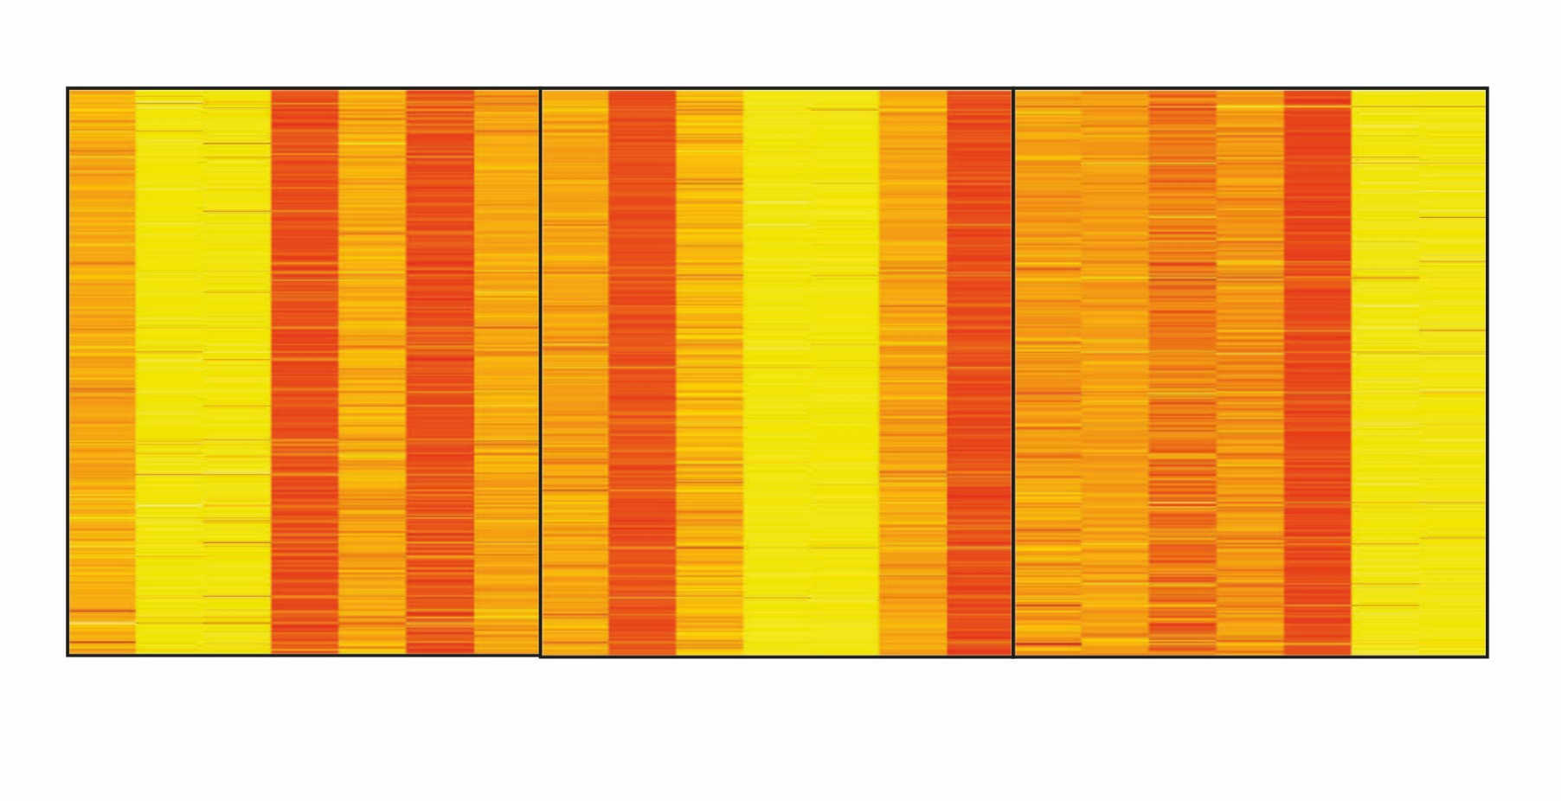
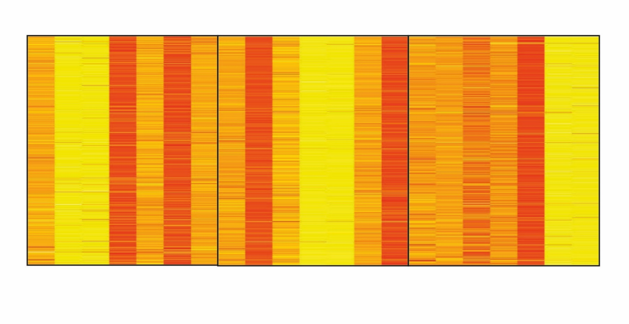

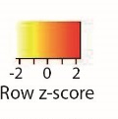
kallisto: accurate read mapping in polyploid wheat
Chromosome 1 nullitetrasomic lines; root RNA-seq samples
1A genes
1B genes
1D genes
NCBI: SRP028357 from Leach et al., 2014 BMC Genomics 2014, 15:276

Slide 11
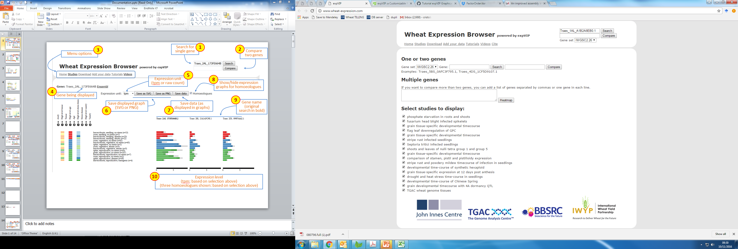

Slide 12
1
2
Search for single gene
Compare two genes

Slide 13
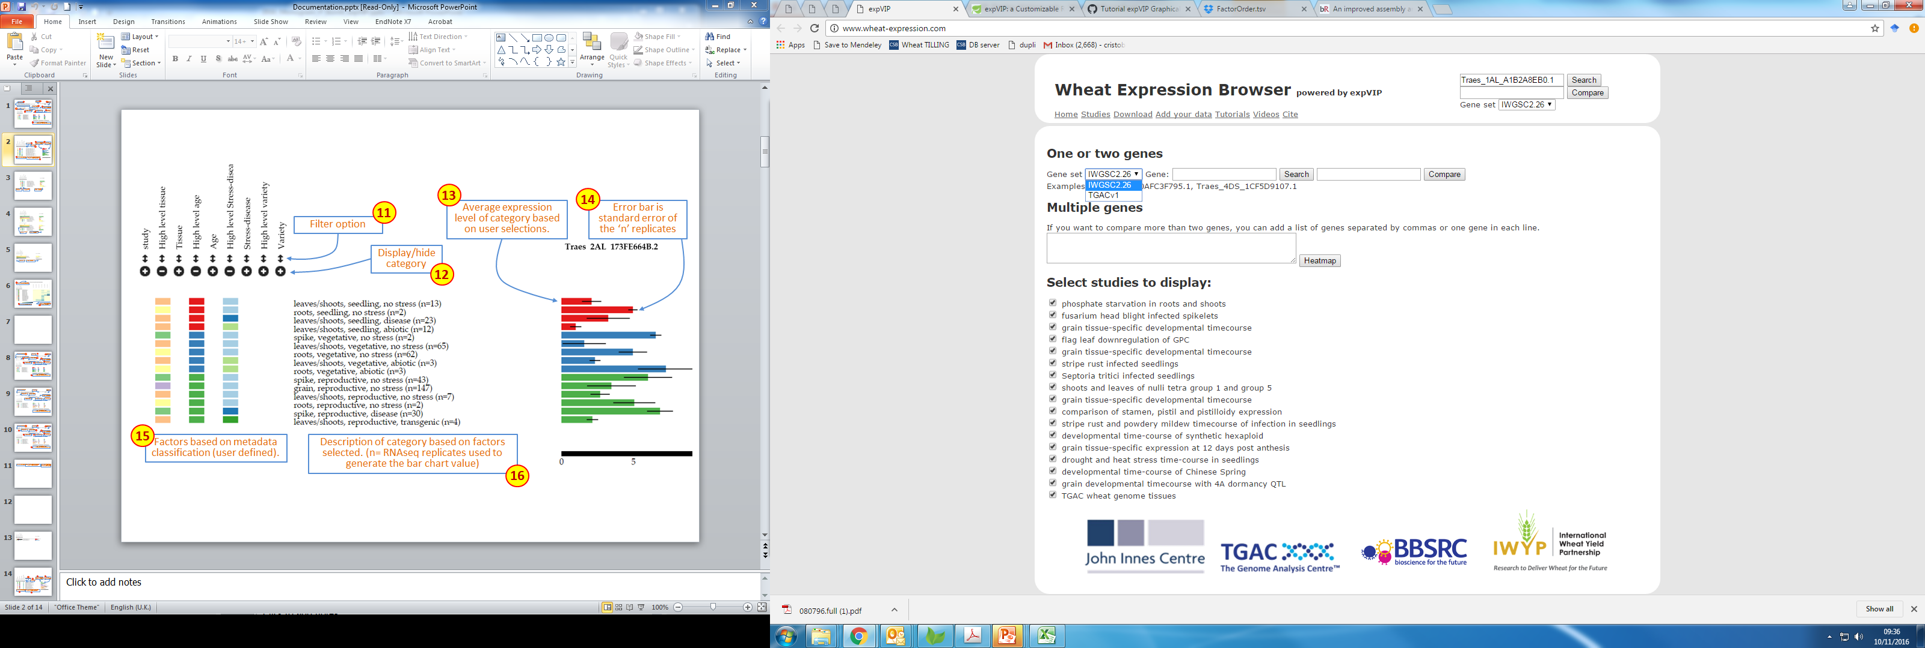
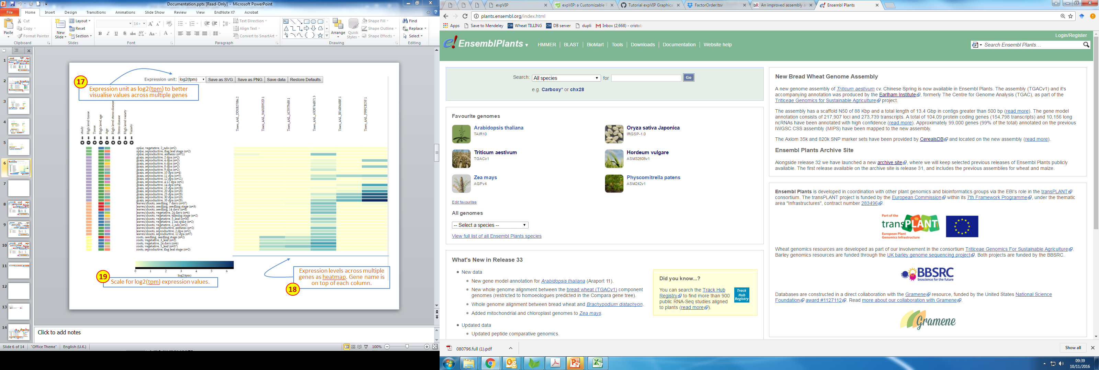
1
2
Search for single gene
Compare two genes
3
Define Reference

Slide 14
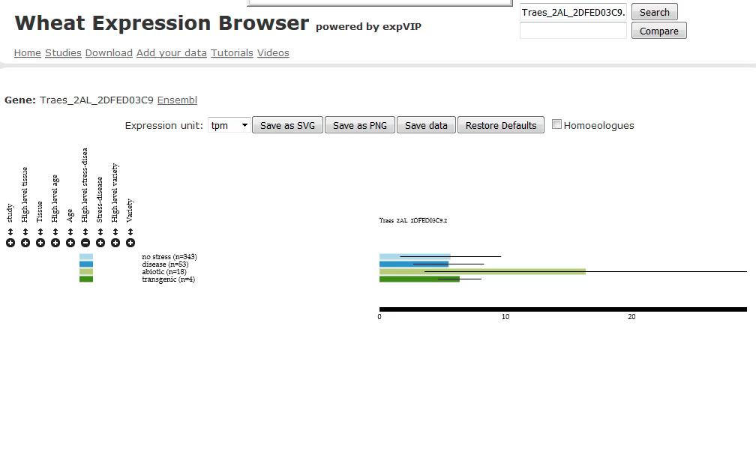
Visual interface (live)

Slide 16
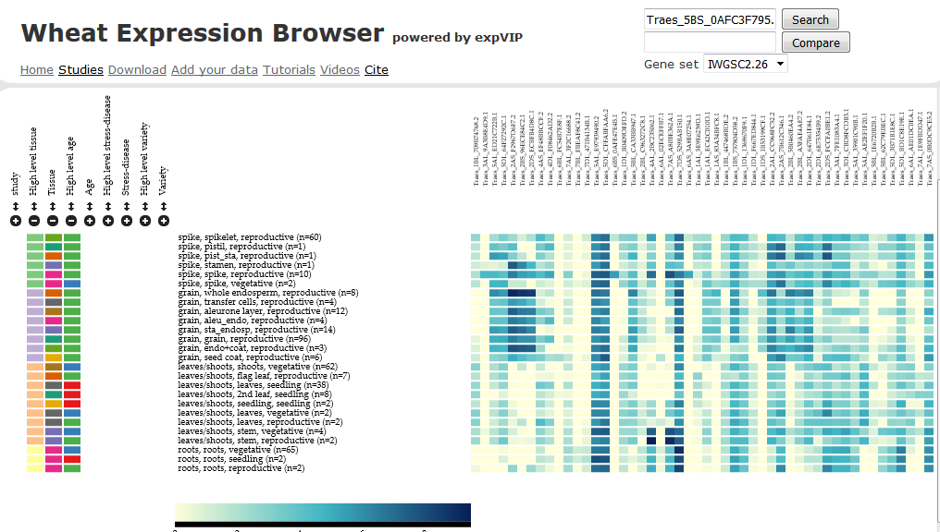
Visual interface: heatmap

Slide 17
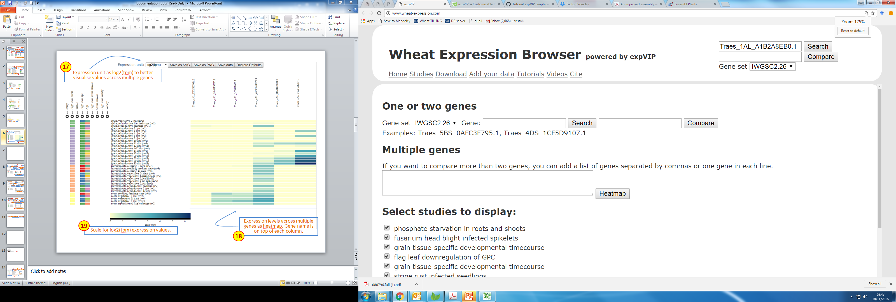
Home page: www.wheat-expression.com

Slide 18
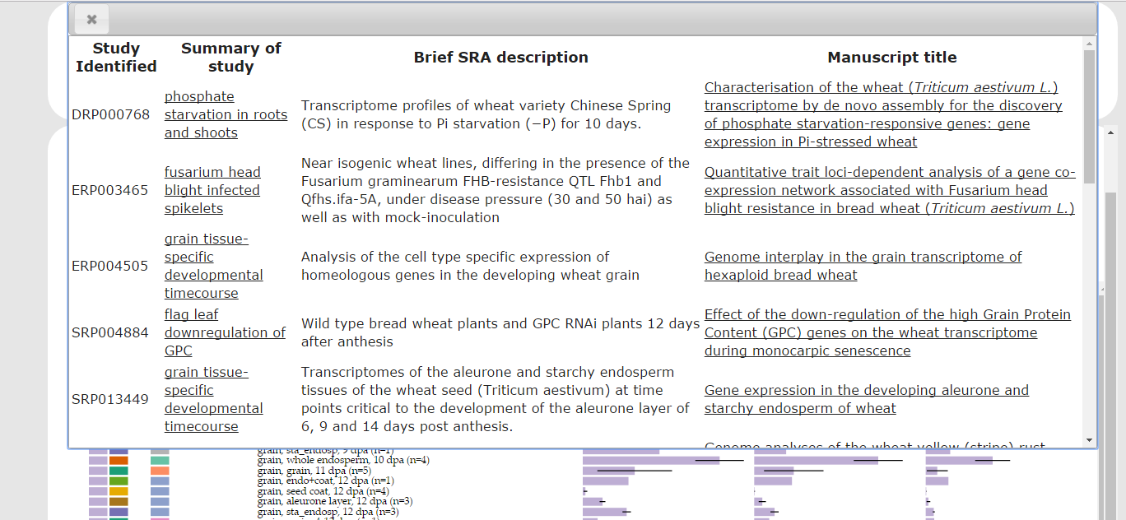

Slide 19
Download: All expression value, metadata, etc
Abundance files (differential expression Sleuth)
Counts (differential expression DeSeq, EdgeR)

Slide 20
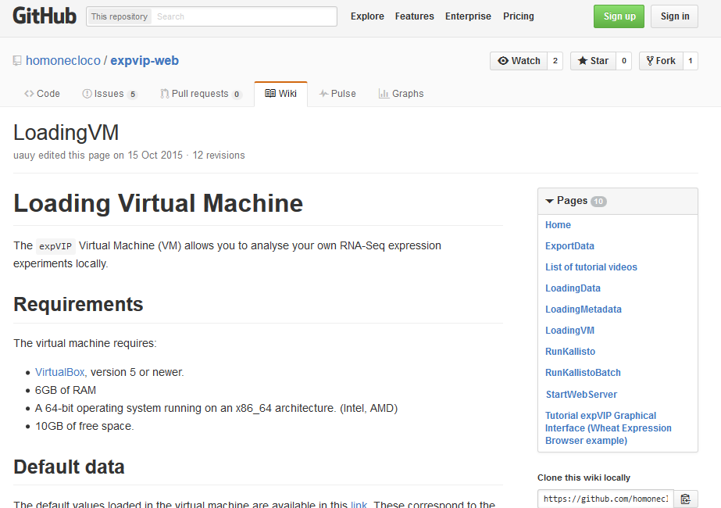
Add your data: download Virtual Machine
With all wheat data
Empty (any transcriptome)

Slide 21
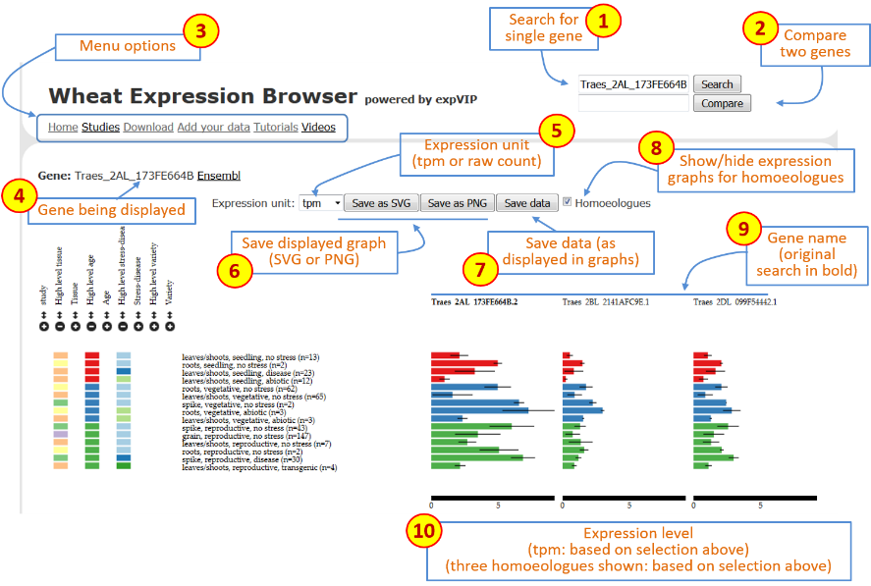
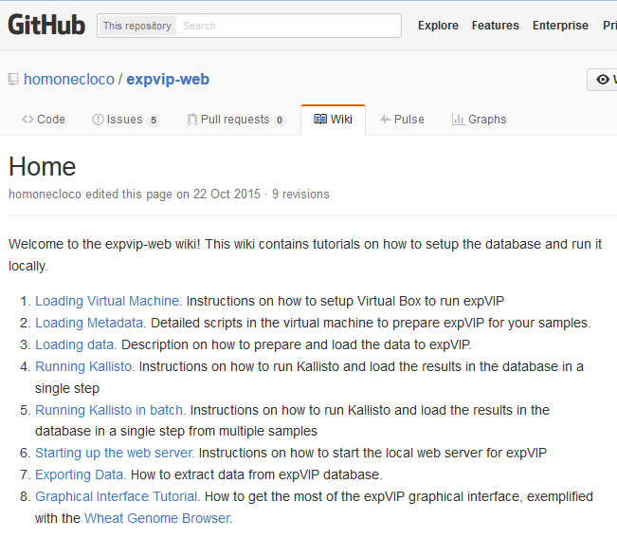
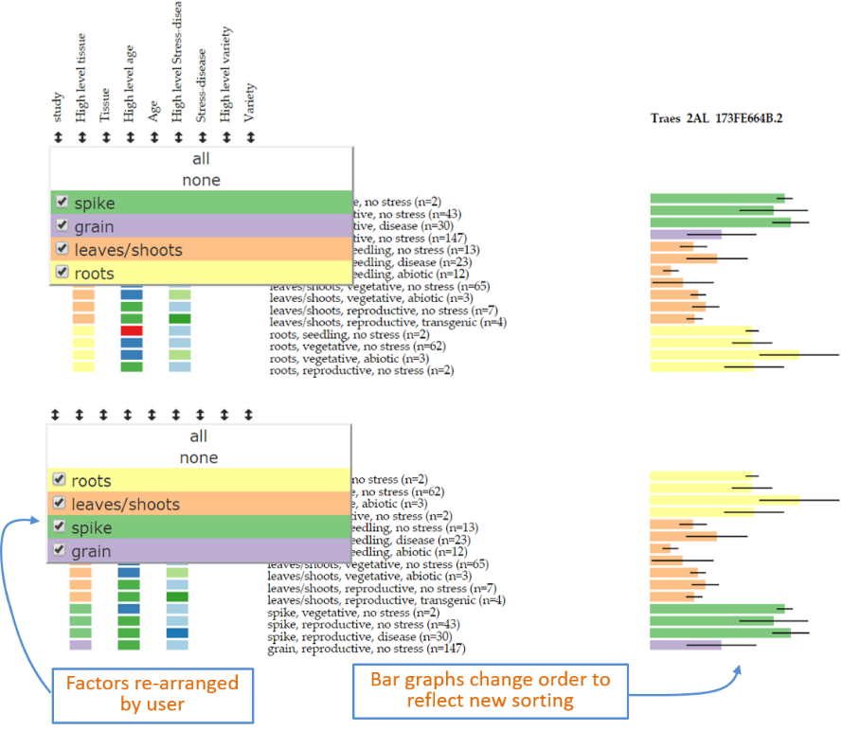

Slide 22
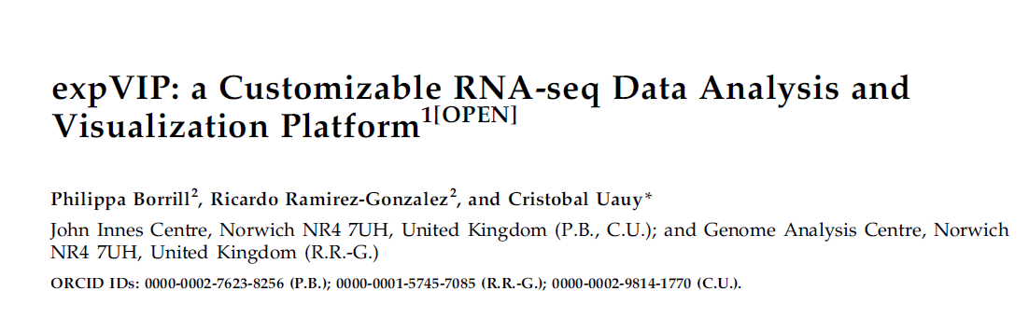
Plant Physiology April 2016 170: 2172-2186
http://www.plantphysiol.org/content/170/4/2172
Source code:
Database and interface setup:
https://github.com/homonecloco/expvip-web
BioJS visualisation component:
http://biojs.io/d/bio-vis-expression-bar

Slide 23


Updated www.wheat-expression.com
Finalise IWGSC samples to run on new transcriptome reference
Previous ~420 + new SRA data Aug2015 ->(Illumina; replicated)
Could include results to publish and for future publication (prefer to run once and then show or not data according to provider’s wishes)
Community feedback very welcomed!
Philippa Borrill
Ricardo Ramirez-Gonzalez

Slide 24
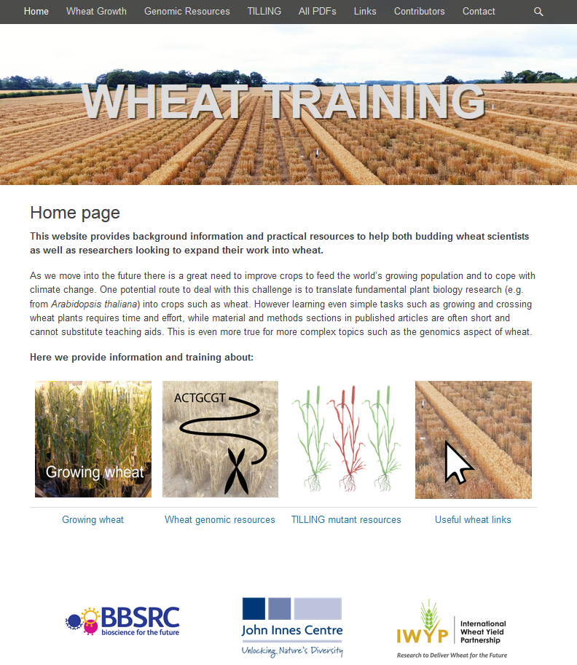
www.wheat-training.com

Slide 25
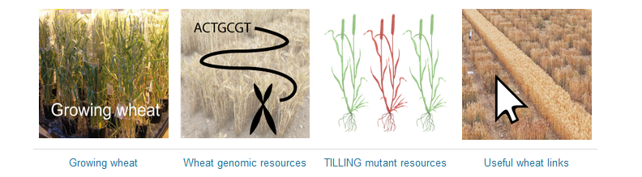
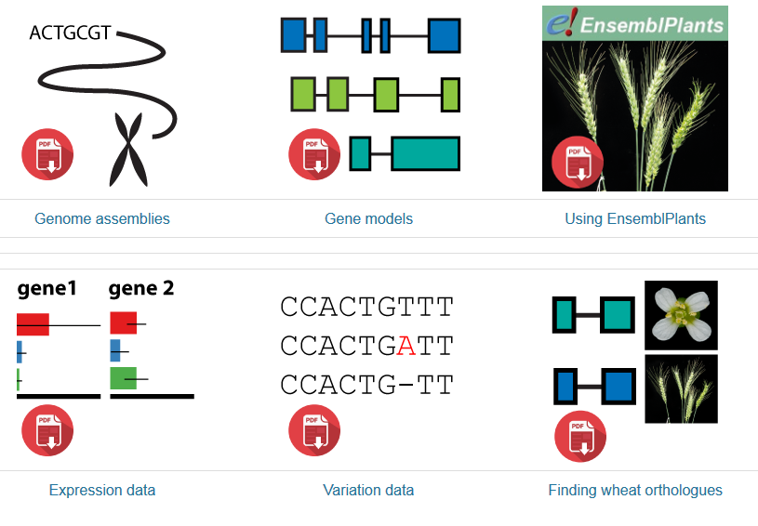
Wheat Genomic Resources

